Slide 1

E-Voting
By Yash (19DCE056) & Tanmay(19DCE021)

Slide 2
Problem statement
To Make A Electronic Voting System.
Goal: To save time, avoid corruption in some ways.
Motivation: This Year I (Yash) got an idea to during election to make a E-voting System.

Slide 3
General Hypothesis
For Voting, the general process is that people have to go to their ward’s held location to vote.
Stand in a long line there, & finally vote.

Slide 4
General Hypothesis
Cont.
Problems with this process: -
People have to be present in their ward location.
Distribution of voter slips won’t be required anymore, which saves a lot of man-power of Govt. Employees.
People Have to stand in a line to vote.
Checking in small villages/cities is not done properly in some places, so frauds can be committed.

Slide 5
Proposed Hypothesis
Our Conceptual system will solve these problems:
People Don’t have to be in their ward location.
People Won’t have to stand in lines.
No frauds can be committed.
No voter slip distribution is required.

Slide 6

Software Requirements
Python: For coding Schemas & in Django Framework.

Slide 7

Software Requirements
Cont.
Django: For connection Database, Back-End & Front-End in order to make a web-app.

Slide 8

Software Requirements
Cont.
GitHub: To Be Easily able to contribute to the code by team members & To Organize our Code as we make Progress.

Slide 9



Software Requirements
Cont.
Text-Editors: For Coding with Ease.

Slide 10
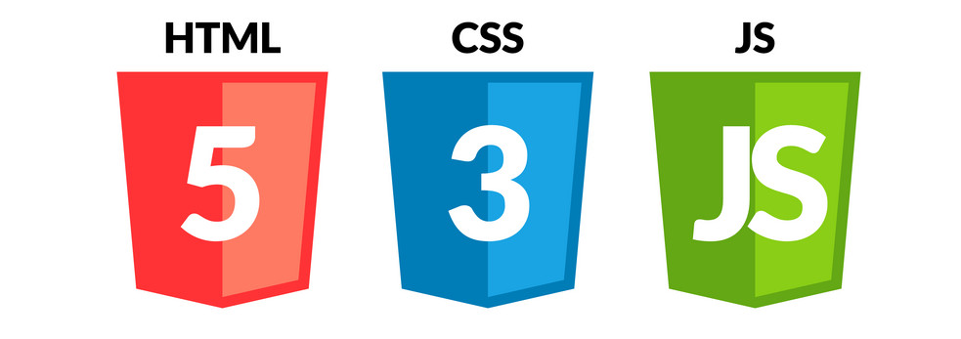
Software Requirements
Cont.
Front-End Technologies: For Making Web pages.

Slide 11
Project Planning
Jan 10
Feb 13
Learning About how the election process works
10 days
Jan 31 - Feb 13
1 day
Start Coding (stater project)
Feb 13
Feb 15
Front - End Coding
Feb 15
13 days
Mar 3
Back - End Coding (Part -1) (Account Based Login)
Mar 4
4 days
Mar 9
Learning About How an election is held
Mar 23
7 days
Mar 31
Back - End Coding (Part -2) (Held an Election Online)
Apr 1
7 days
Apr 10
Finsihing Touches
Apr 10
5 days
Apr 16
2021
Jan
Feb
Mar
Apr
2021
Today

Slide 12
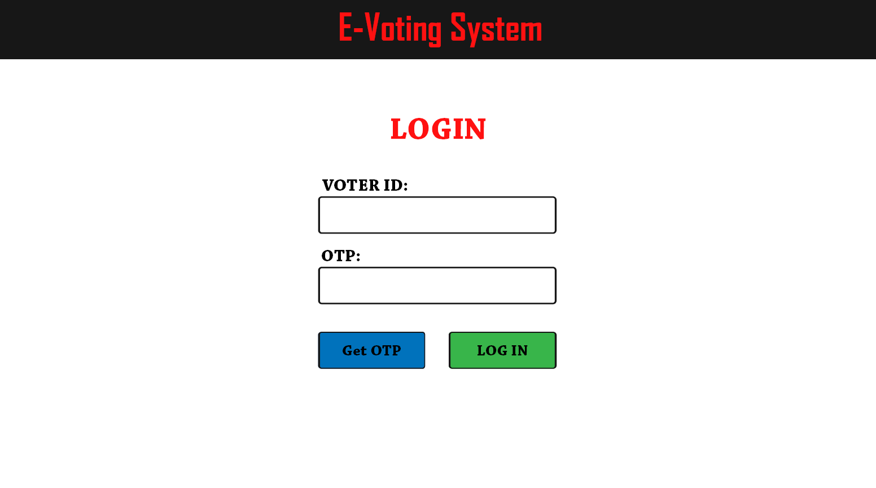
Prototypes For Front-End

Slide 13
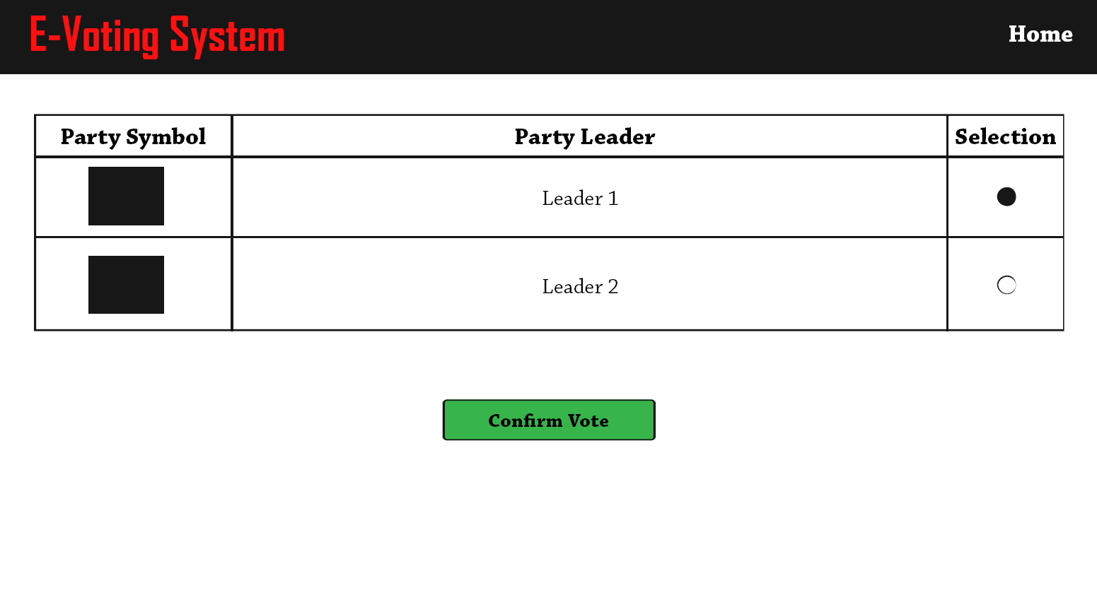
Prototypes For Front-End
Cont.

Slide 14
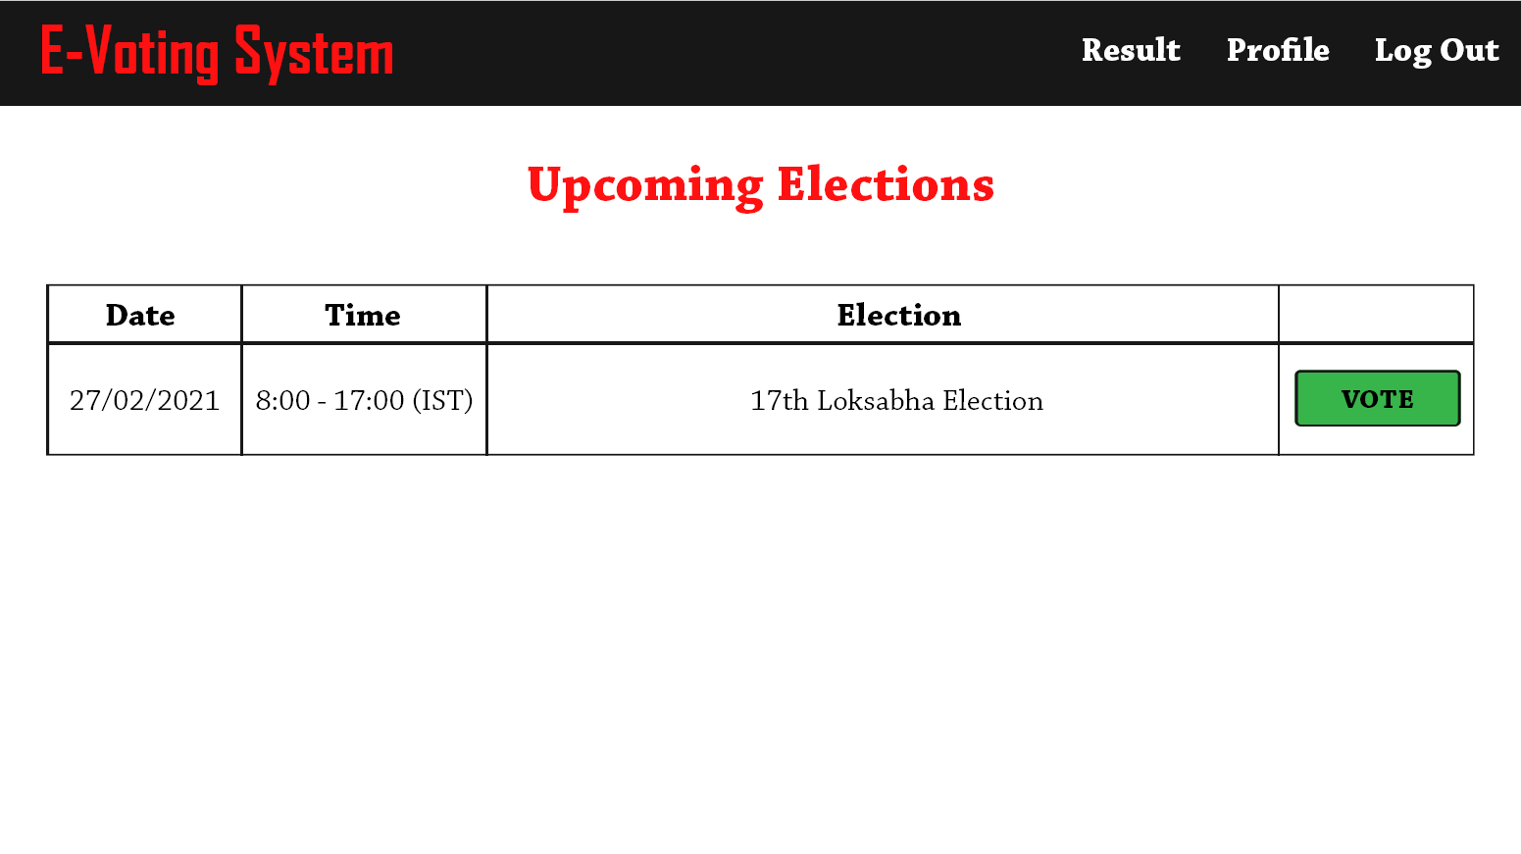
Prototypes For Front-End
Cont.

Slide 15
Roles Of Each Group Member
Yash – Front-End, UI Design & Concept Design, etc.
Tanmay – Back-End, Database Management, Coding logic for voting, etc.

Slide 16
Expected Outcome
For College Project Purposes: A Concept Website made for E-Voting.
For Us:
To Learn About Election Process, How an Election Is held, How counting is done, etc.
Getting Better at Coding with Django.
Getting Better at Coding with Front-End Technologies.
Hosting A Website.

Slide 17
Thank You !

